Slide 1

Hands-on Intro to Spark & Zeppelin
Robert Hryniewicz
Data Advocate
Twitter: @RobH8z
Email: rhryniewicz@hortonworks.com
#FutureOfData

Slide 2
Agenda
Background
Spark Overview
Zeppelin Overview
Components of HDP
Lab ~ 45min

Slide 3


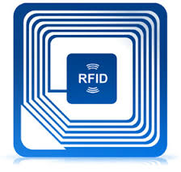





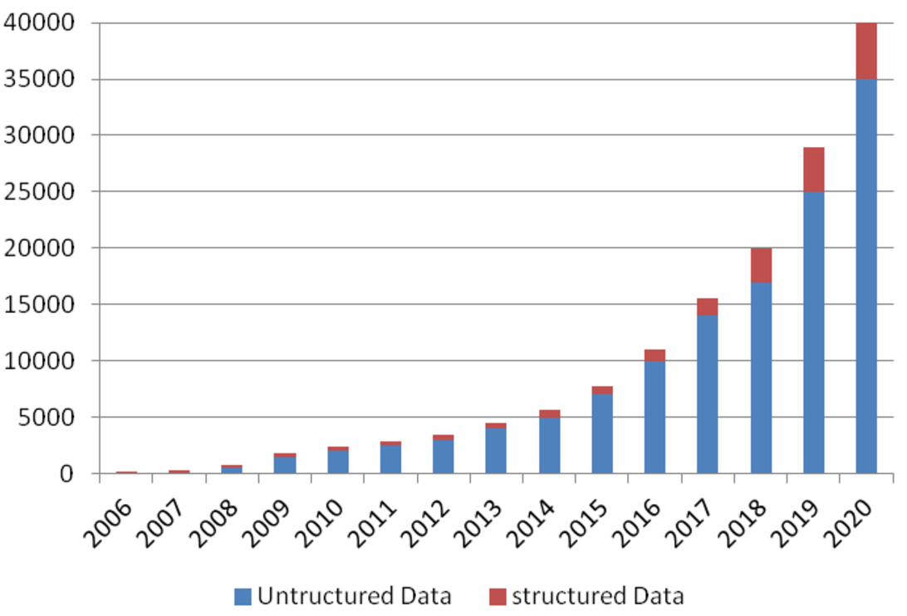
Data Sources
Internet of Anything (IoAT)
Wind Turbines, Oil Rigs, Cars
Weather Stations, Smart Grids
RFID Tags, Beacons, Wearables
User Generated Content (Web & Mobile)
Twitter, Facebook, Snapchat, YouTube
Clickstream, Ads, User Engagement
Payments: Paypal, Venmo
44ZB in 2020

Slide 4
The “Big Data” Problem
Problem
A single machine cannot process or even store all the data!
Solution
Distribute data over large clusters
Difficulty
How to split work across machines?
Moving data over network is expensive
Must consider data & network locality
How to deal with failures?
How to deal with slow nodes?

Slide 5
Spark Background

Slide 6
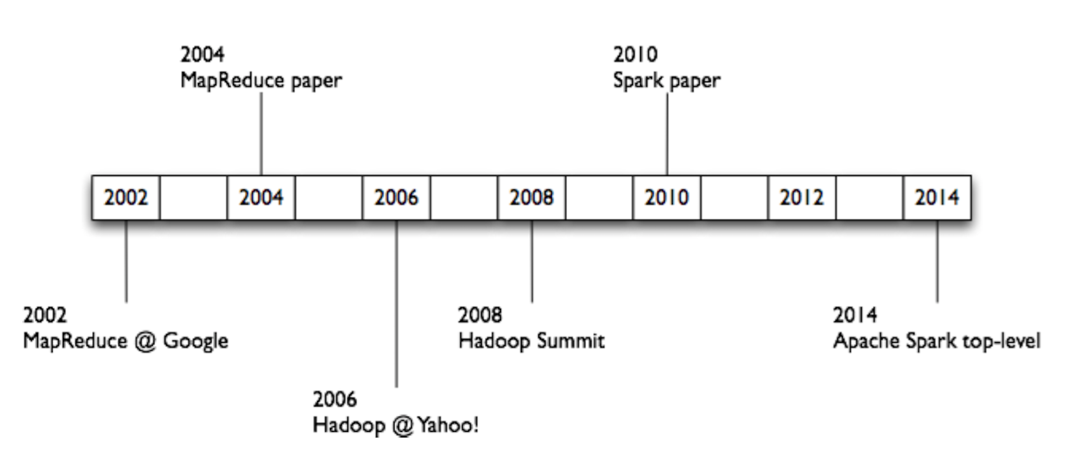
History of Hadoop & Spark

Slide 7
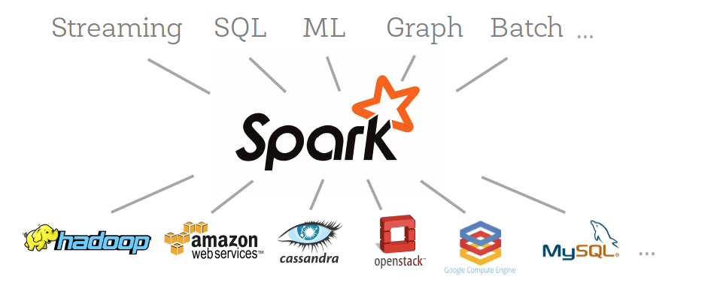
What Is Apache Spark?
Apache open source project originally developed at AMPLab (University of California Berkeley)
Unified data processing engine that operates across varied data workloads and platforms

Slide 8
Why Apache Spark?
Elegant Developer APIs
Single environment for data munging, data wrangling, and Machine Learning (ML)
In-memory computation model – Fast!
Effective for iterative computations and ML
Machine Learning
Implementation of distributed ML algorithms
Pipeline API (Spark ML)

Slide 9
Spark Ecosystem
Spark SQL
Spark Streaming
Spark MLlib
GraphX
Spark Core

Slide 10
Apache Spark Basics

Slide 11

Spark Context
What is it?
Main entry point for Spark functionality
Represents a connection to a Spark cluster
Represented as sc in your code (in Zeppelin)
Notes:
Spark 1.6.2 & older uses Spark Context → sc
Spark 2.0+ uses Spark Session → spark

Slide 12
Spark SQL

Slide 13
Spark SQL Overview
Spark module for structured data processing (e.g. DB tables, JSON files, CSV)
Three ways to manipulate data:
DataFrames API
SQL queries
Datasets API

Slide 14
DataFrames
Column
Distributed collection of data organized into named columns
Conceptually equivalent to a table in relational DB or a data frame in R/Python
API available in Scala, Java, Python, and R
Col1 | Col2 | … | … | ColN
Row
DataFrame
Data is described as a DataFrame with rows, columns, and a schema

Slide 15
DataFrames
Avro
Column
Text
CSV
Created from Various Sources
JSON
DataFrames from HIVE:
Reading and writing HIVE tables
DataFrames from files:
Built-in: JSON, JDBC, ORC, Parquet, HDFS
External plug-in: CSV, HBASE, Avro
Col1 | Col2 | … | … | ColN
Spark SQL
Row
HIVE
DataFrame

Slide 16
SQL Context
SQLContext
Entry point into all functionality in Spark SQL
All you need is SparkContext
val sqlContext = SQLContext(sc)
Use when your data resides in Hive
HiveContext
Superset of functionality provided by basic SQLContext
Read data from Hive tables
Access to Hive Functions → UDFs
val hc = HiveContext(sc)
Notes:
As of Spark 1.6.2

Slide 17
Spark SQL Examples

Slide 18
Setting up DataFrame API
Create a DataFrame
val flightsDF = … ⬅ Create from CSV, JSON, Hive etc.
Example:
val path = "examples/flights.json"
val flightsDF = sqlContext.read.json(path)

Slide 19
Setting up SQL API
Register a Temporary Table
flightsDF.registerTempTable("flights")

Slide 20
Two API Examples: DataFrame and SQL APIs
DataFrame API
flightsDF.select("Origin", "Dest", "DepDelay”)
.filter($"DepDelay" > 15).show(5)
Results
SELECT Origin, Dest, DepDelay FROM flights WHERE DepDelay > 15 LIMIT 5
+------+----+--------+
|Origin|Dest|DepDelay|
+------+----+--------+
| IAD| TPA| 19|
| IND| BWI| 34|
| IND| JAX| 25|
| IND| LAS| 67|
| IND| MCO| 94|
+------+----+--------+
SQL API

Slide 21
Spark Streaming

Slide 22


What is Stream Processing?
Batch Processing
Ability to process and analyze data at-rest (stored data)
Request-based, bulk evaluation and short-lived processing
Enabler for Retrospective, Reactive and On-demand Analytics
Stream Processing
Ability to ingest, process and analyze data in-motion in real- or near-real-time
Event or micro-batch driven, continuous evaluation and long-lived processing
Enabler for real-time Prospective, Proactive and Predictive Analytics for Next Best Action
Stream Processing + Batch Processing = All Data Analytics
real-time (now)
historical (past)

Slide 23
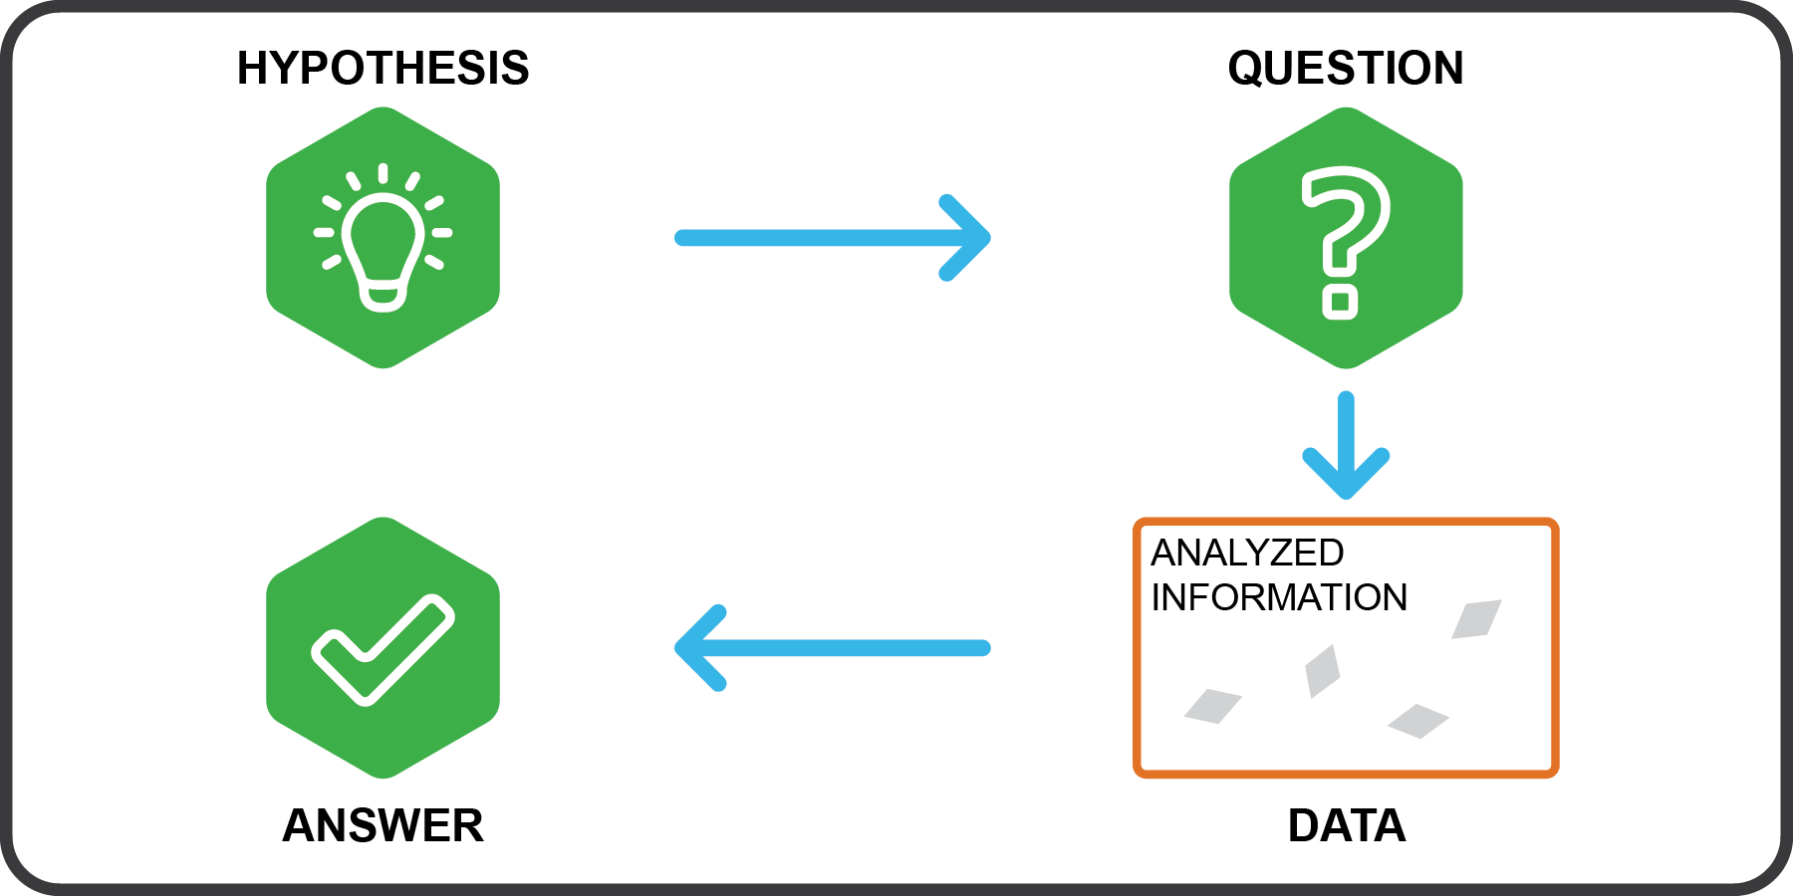
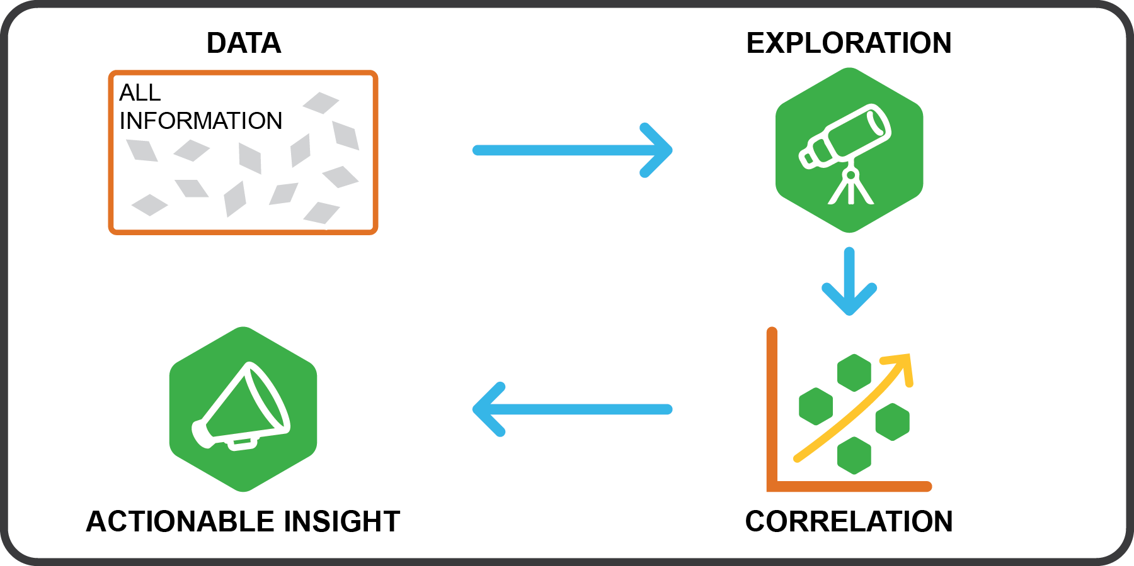
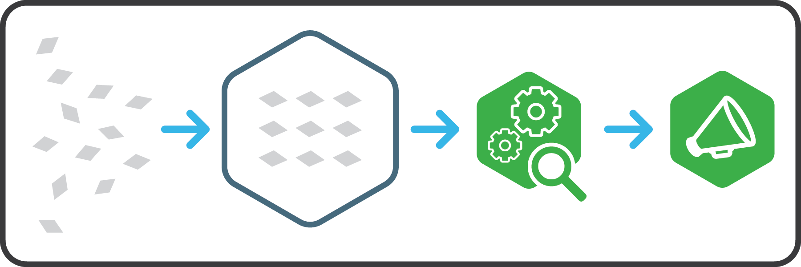
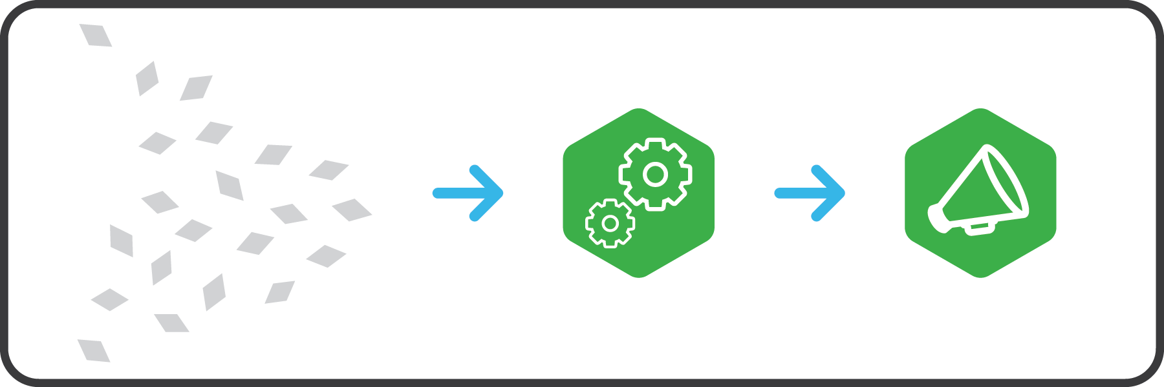
Modern Data Applications approach to Insights
Traditional Analytics Structured & Repeatable Structure built to store data
Next Generation Analytics Iterative & Exploratory Data is the structure
Start with hypothesis
Test against selected data
Data leads the way Explore all data, identify correlations
Analyze after landing…
Analyze in motion…
23

Slide 24
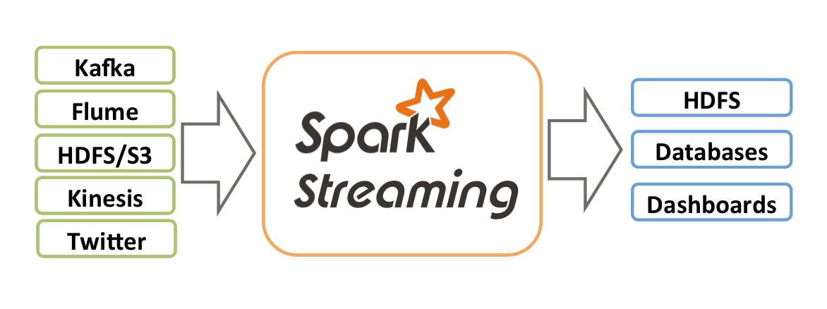
Spark Streaming
Overview
Extension of Spark Core API
Stream processing of live data streams
Scalable
High-throughput
Fault-tolerant
ZeroMQ
MQTT

Slide 25
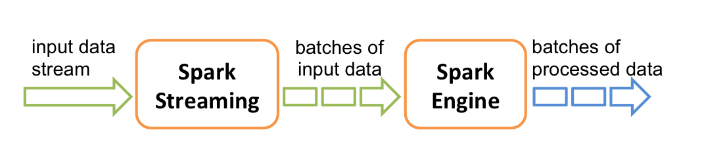
Spark Streaming
Notes:
micro-batches

Slide 26
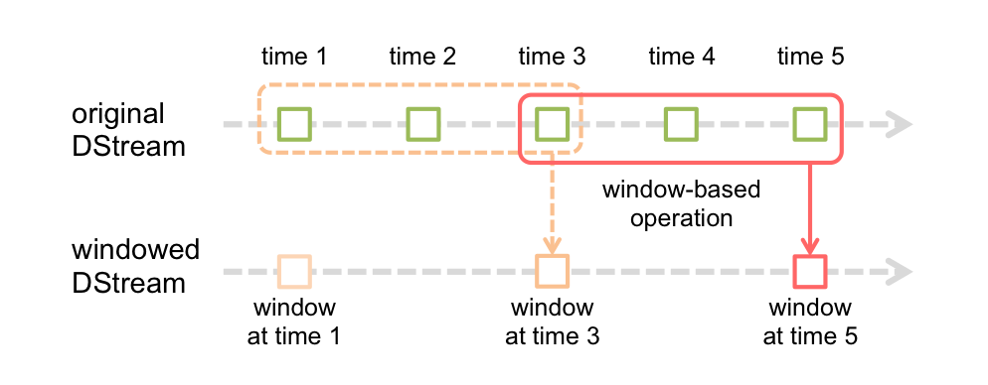
Spark Streaming
Window Operations
Apply transformations over a sliding window of data, e.g. rolling average

Slide 27
Spark MLlib

Slide 28
Where Can We Use Machine Learning (Data Science)
Healthcare
Financial services
Public Sector
Retail
Predict diagnosis
Prioritize screenings
Fraud Detection/prevention
Predict underwriting risk
Analyze public sentiment
Optimize resource allocation
Product recommendation
Inventory management
Telco/mobile
Oil & Gas
Predictive maintenance
Seismic data management
Predict customer churn
Price optimization
Predict equipment failure
Reduce re-admittance rates
New account risk screens
Customer behavior analysis
Predict well production levels
Law enforcement & security

Slide 29
Spark ML: Spark API for building ML pipelines
Feature transform 1
Feature transform 2
Combine features
Linear
Regression
Pipeline
Train
Input DataFrame
Pipeline Model
Export Model
Predict
Input DataFrame
Output DataFrame

Slide 30
Spark GraphX

Slide 31
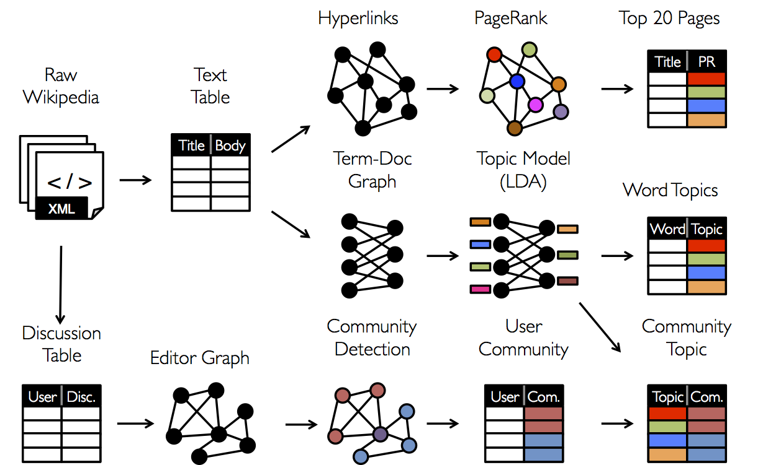
GraphX
Page Rank
Topic Modeling (LDA)
Community Detection
Source: ampcamp.berkeley.edu

Slide 32
Apache Zeppelin & HDP Sandbox

Slide 33
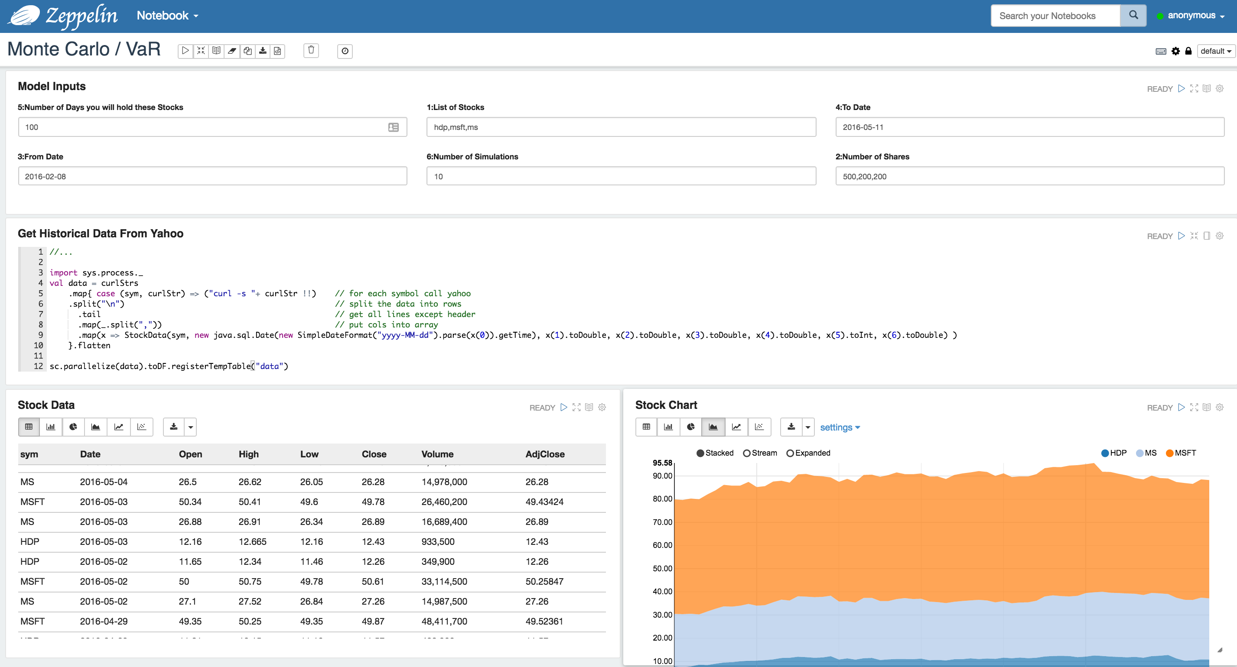
What’s Apache Zeppelin?
Web-based notebook that enables interactive data analytics.
You can make beautiful data-driven, interactive and collaborative documents with SQL, Scala and more
Notes:
Data exploration, visualization, and discovery
Deeply integrated with Spark and Hadoop
Pluggable interpreters
Multiple languages in one notebook: R, Python, Scala

Slide 34
What is a Note/Notebook?
A web based GUI for small code snippets
Write code snippets in browser
Zeppelin sends code to backend for execution
Zeppelin gets data back from backend
Zeppelin visualizes data
Zeppelin Note = Set of (Paragraphs/Cells)
Other Features - Sharing/Collaboration/Reports/Import/Export
Notes:
It’s not an IDE
It’s not a BI tool

Slide 35
Big Data Lifecycle
Business user
Customer
Report
Data Engineer
Data Scientist
Collect
ETL /
Process
Analysis
Data
Product
All in one place in Zeppelin!

Slide 36

How does Zeppelin work?
Notebook Author
Zeppelin
Cluster
Spark | Hive | HBase Any of 30+ back ends
Collaborators/
Report viewers

Slide 37

HDP Sandbox
What’s included in the HDP Sandbox?
Zeppelin
Spark
YARN → Resource Management
HDFS → Distributed Storage Layer
And many more components: Hive, Solr etc.
Scala Java Python
R APIs
MLlib
Spark
SQL
Spark Streaming
GraphX
Spark Core Engine
YARN
HDFS
1
°
°
°
°
°
°
°
°
°
°
°
°
°
°
°
°
°
°
°
°
N

Slide 38
Access patterns enabled by YARN
Applications
Batch Needs to happen but, no timeframe limitations
Interactive Needs to happen at Human time
Real-Time Needs to happen at Machine Execution time.
Batch
Interactive
Real-Time
YARN: Data Operating System
HDFS Hadoop Distributed File System
1
°
°
°
°
°
°
°
°
°
°
°
°
°
°
°
°
°
°
°
N
°

Slide 39
Why Apache Spark on YARN?
YARN container
Resource management
Share Spark workloads with other workloads (HIVE, Solr, etc.)
Utilizes existing HDP cluster infrastructure
Scheduling and queues
Client
Spark
Application Master
Spark Driver
Spark Executor
Spark Executor
Spark Executor
Task
Task
Task
Task
Task
Task
YARN container
YARN container
YARN container

Slide 40
Why HDFS?
Fault Tolerant Distributed Storage
Divide files into big blocks and distribute 3 copies randomly across the cluster
Processing Data Locality
Not Just storage but computation
1
Cluster
101101001010010011100111111001010011101001010010110010010101001100010100101110101110101111011011010101101001010100101010101011100100110101110100
1
3
2
2
4
1
3
Blocks
3
2
4
4
2
3
4
1
Logical File
Notes:
HDFS – Hadoop Distributed File System

Slide 41

There’s more to HDP
DATA ACCESS
GOVERNANCE & INTEGRATION
SECURITY
OPERATIONS
Hortonworks Data Platform 2.4.x
DATA MANAGEMENT
Data Lifecycle & Governance
Falcon
Atlas
Batch
MapReduce
Script
Pig
SQL
Hive
NoSQL
HBase
Accumulo
Phoenix
Stream
Storm
Search
Solr
In-memory
Others
ISV Engines
Administration
Authentication
Authorization
Auditing
Data Protection
Ranger
Knox
Atlas
HDFS Encryption
Provisioning, Managing, & Monitoring
Ambari
Cloudbreak
Zookeeper
Tez
Tez
Slider
Slider
YARN : Data Operating System
Data Workflow
Sqoop
Flume
Kafka
NFS
WebHDFS
HDFS Hadoop Distributed File System
1
°
°
°
°
°
°
°
°
°
°
Scheduling
Oozie
°
°
°
°
°
°
°
°
°
°
N
Deployment Choice
Linux
Windows
On-Premise
Cloud

Slide 42
Sample Architecture

Slide 43


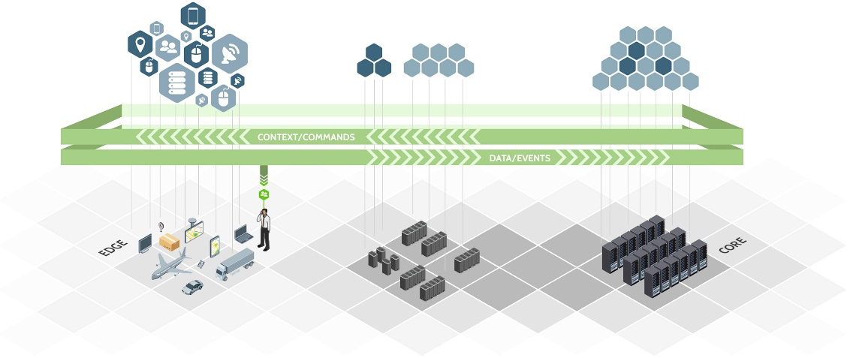
Managed Dataflow
SOURCES
REGIONAL INFRASTRUCTURE
CORE INFRASTRUCTURE

Slide 44
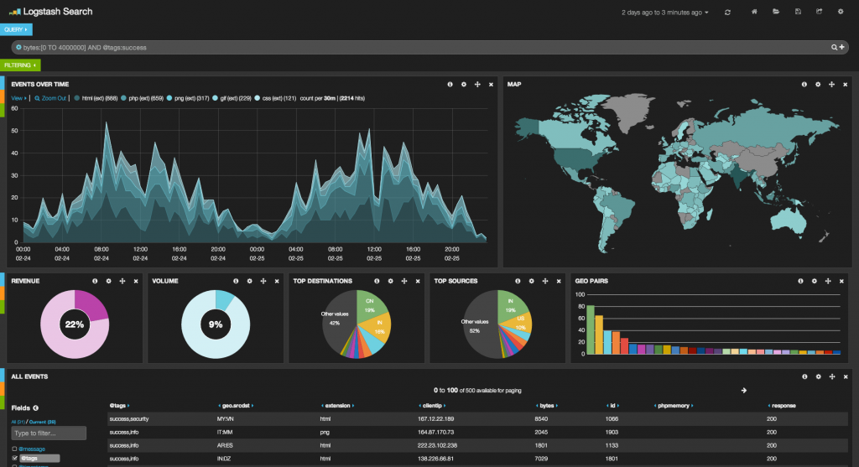





High-Level Overview
Live Dashboard
IoT Devices
IoT Edge
(single node)
NiFi Hub
Data Broker
Data Store
Column DB
HDFS/S3
HBase/Cassandra
IoT Devices
IoT Edge
(single node)
Data Center (on prem/cloud)
Notes:
NiFi: simple event processing
Spark: complex event processing

Slide 45
What’s new in Spark 2.0

Slide 46
Spark 2.0
API Improvements
SparkSession (spark) – new entry point (Replaces SparkContext, SQLContext, HiveContext)
Unified DataFrame & DataSet API (DataFrame → alias for DataSet[Row])
Structured Streaming/Continuous Application (Concept of an infinite DataFrame)
Performance Improvements
Tungsten Phase 2 - Multi stage code gen
ORC & Parquet file improvements
Machine Learning
ML pipeline the new API, MLlib deprecated
Distributed R algorithms (GLM, Naïve Bayes, K-Means, Survival Regression)
SparkSQL
More SQL support (new ANSI SQL parser, subquery support)
Note: Zeppelin support for Spark 2.0 is coming soon to HDP.

Slide 47

What’s the latest at Hortonworks?
Modern Data Applications
HDP 2.5
Batch Processing
HDF 2.0
Streaming Apps
ACTIONABLE INTELLIGENCE
DATA IN MOTION
DATA AT REST

Slide 48
Lab Preview

Slide 49
Lab Setup Instructions
http://tinyurl.com/hwx-spark-intro

Slide 50
Hortonworks Community Connection

Slide 51
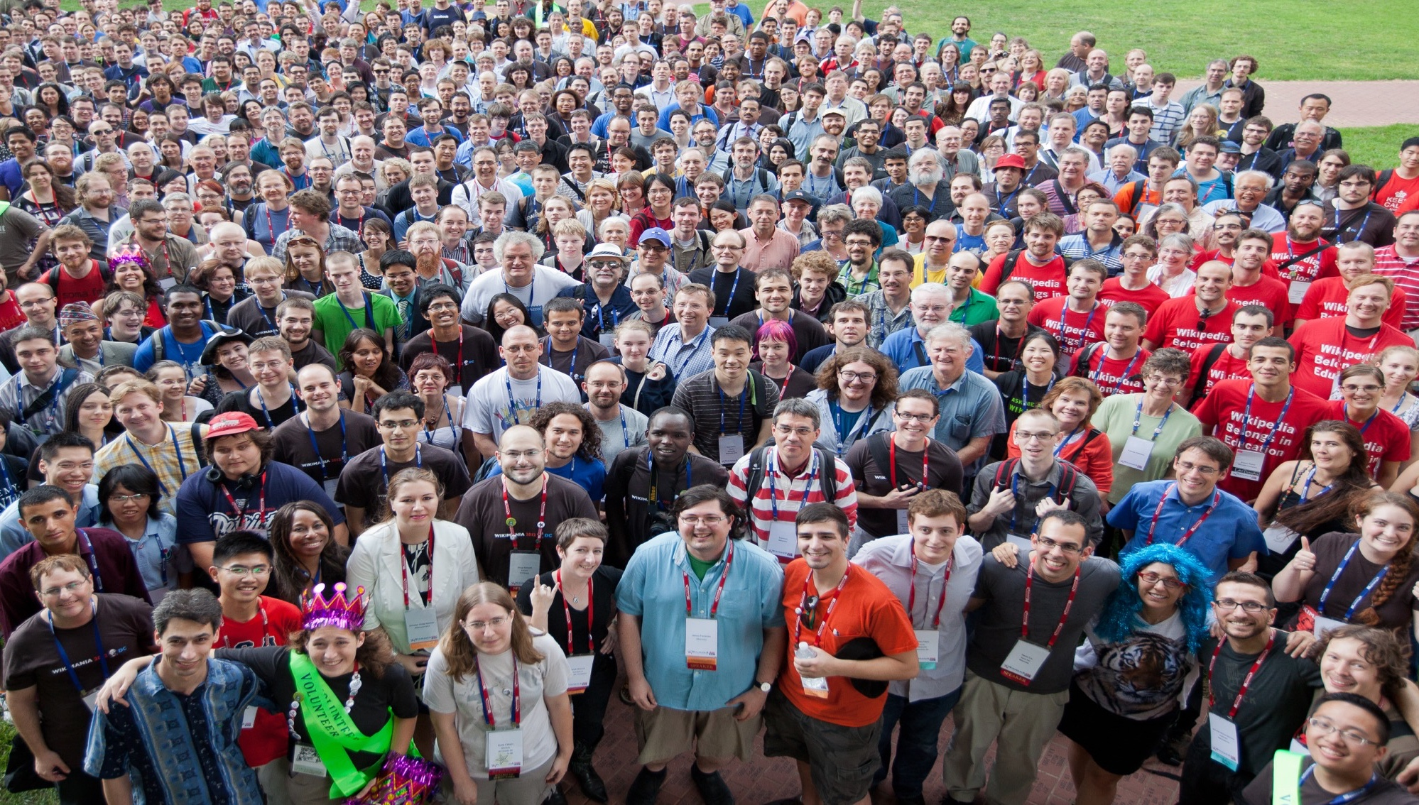

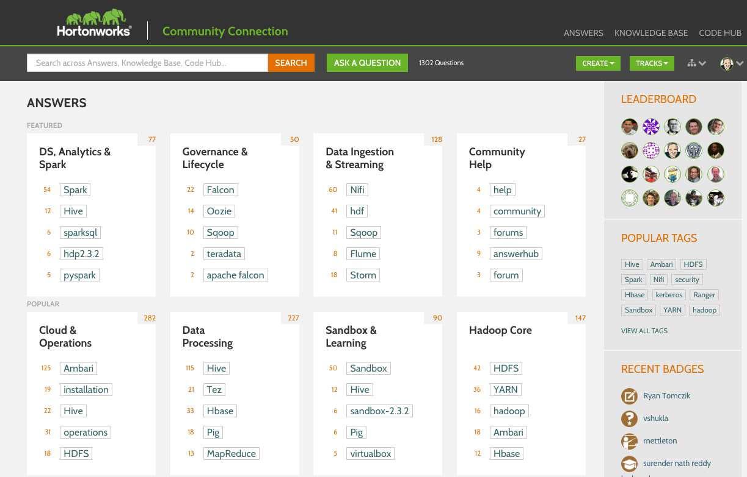
Community Engagement
One Website!
8,400+
Registered Users
21,000+
Answers
32,500+
Technical Assets
© Hortonworks Inc. 2011 – 2015. All Rights Reserved
Participate now at: community.hortonworks.com

Slide 52
Hortonworks Community Connection
Full Q&A Platform (like StackOverflow)
Knowledge Base Articles
Code Samples and Repositories
Read access for everyone, join to participate and be recognized

Slide 53
Thanks!
Robert Hryniewicz
E: rhryniewicz@hortonworks.com
T: @RobH8z
#FutureOfData

